Slide 1

Capstone Project-2
Bike Sharing Demand Prediction
PREPARED BY
PANKAJ KUMAR

Slide 2
PROBLEM STATEMENT
Bike sharing is an increasingly popular mode of transportation in many cities. This project aims to predict bike sharing demand in order to better optimize the system and increase ridership. By developing an accurate and efficient model, it will be possible to better forecast and meet rider demand, as well as optimize resource allocation and pricing.

Slide 3
PROJECT WORKFLOW
DATA COLLECTION AND UNDERSTANDING
DATA CLEANING AND DATA WRANGLING
EXPLORATORY DATA ANALYSIS
PROJECT CONCLUSIONS
MODEL IMPLEMENTATION AND EVALUATION
FEATURE ENGINEERING

Slide 4
DATASET DESCRIPTION
Date : year-month-day
Rented Bike count - Count of bikes rented at each hour
Hour - Hour of he day
Temperature-Temperature in Celsius
Humidity - %
Wind speed - m/s
Visibility - 10m
Dew point temperature - Celsius
Solar radiation - MJ/m2
Rainfall - mm
Snowfall - cm
Seasons - Winter, Spring, Summer, Autumn
Holiday - Holiday/No holiday
Functional Day - NoFunc(Non Functional Hours), Fun(Functional hours)

Slide 5
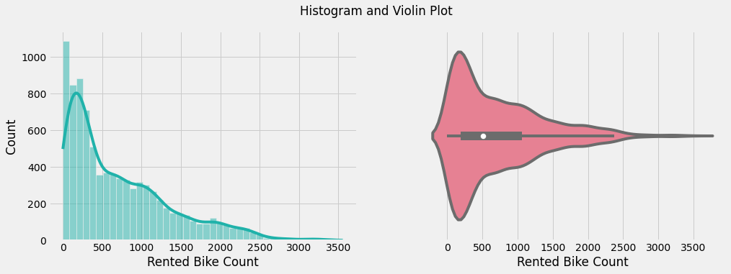
EXPLORATORY DATA ANALYSIS
CONCLUSIONS:
The histogram and violin plot show that the mean of the data is 704 and the median is 504. This suggests that the data may be skewed to the right, as the mean is greater than the median. The skewness of 1.15 confirms this, as a skewness value greater than 0 indicates a right-skewed distribution.Also it is important to note that most of the data points are in the range of (0,500].

Slide 6
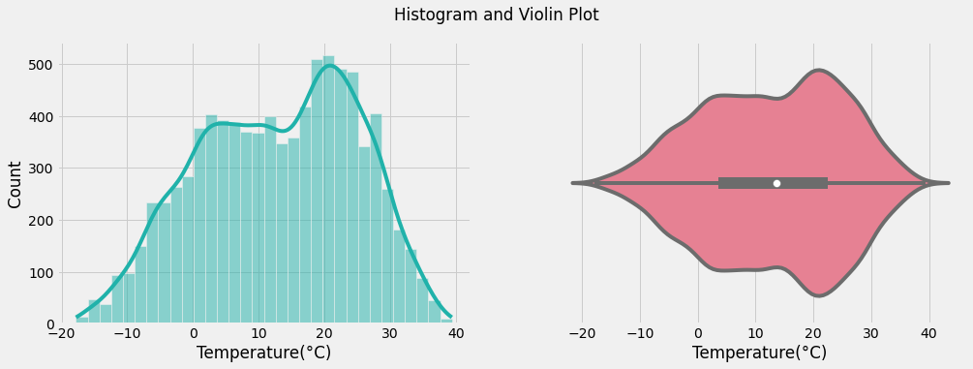
EXPLORATORY DATA ANALYSIS
CONCLUSIONS:
The histogram and violin plot of the temperature data show that the mean of the data is 12.88 and the median is 13.7. This suggests that the data is relatively symmetric, as the mean is close to the median. The skewness of -0.198 confirms this, as a skewness value close to 0 indicates a relatively normal distribution.

Slide 7
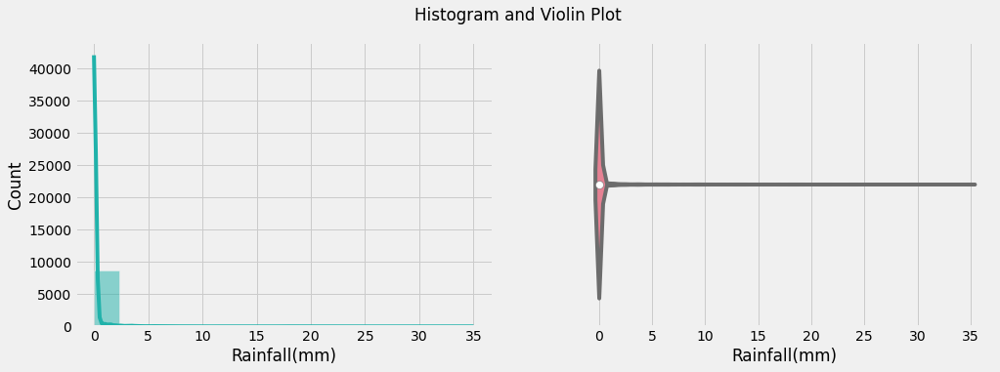
EXPLORATORY DATA ANALYSIS
CONCLUSIONS:
The histogram and violin plot of the rainfall data show that the mean of the data is 0.149 and the median is 0.0. This suggests that the data is heavily skewed to the right, as the mean is much greater than the median. The skewness of 14.53 confirms this, as a skewness value greater than 10 indicates a high degree of skewness.

Slide 8
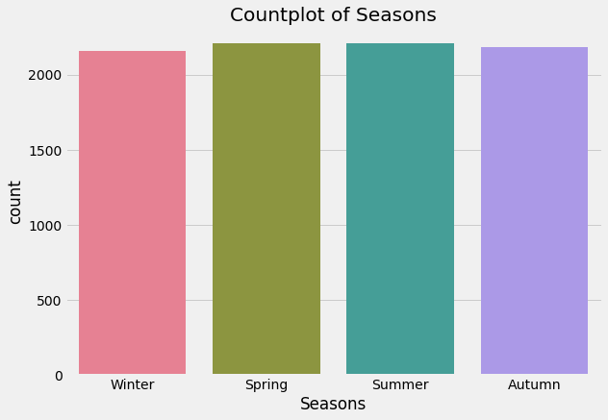
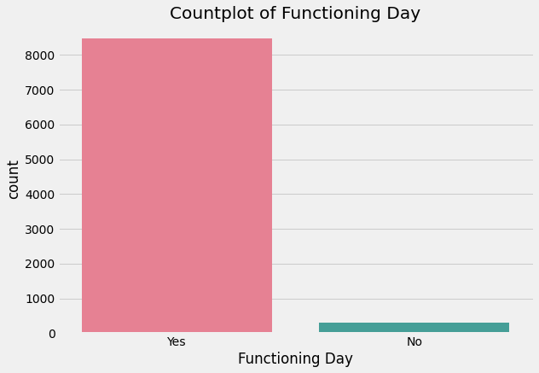
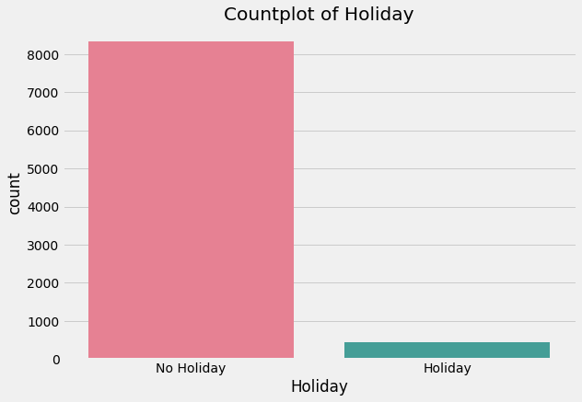
EXPLORATORY DATA ANALYSIS
CONCLUSIONS:
1.All these four categories available in the Season have more or less equal frequency.
2.The frequency of occurrence of "No Holiday" is much greater than "Holiday".
3. Most of the data points are collected when there is functioning day and very less data are collected on non-functioning days.

Slide 9
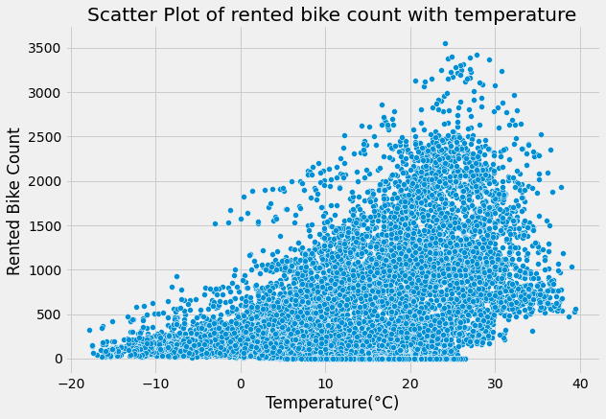

EXPLORATORY DATA ANALYSIS
CONCLUSIONS:
The correlation coefficient of 0.5385 suggests that there is a moderate positive correlation between temperature and rented bike count. A positive correlation means that as the temperature increases, the number of rented bikes also tends to increase. It also suggests that 29% of the variability in the number of rented bikes can be explained by the temperature. This means that temperature is one of the factors that can influence the number of rented bikes.

Slide 10
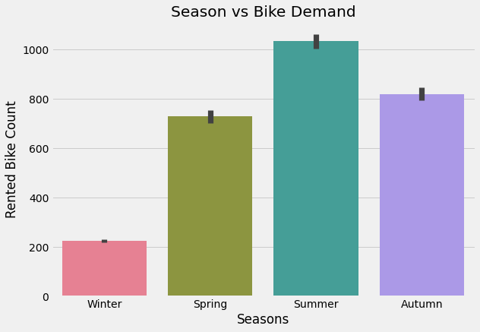
EXPLORATORY DATA ANALYSIS
CONCLUSIONS:
The bar chart showing the rented bike count versus season with summer having the highest demand followed by autumn, spring, and lastly winter. The chart clearly shows that there is a seasonal pattern in the demand for rented bikes, with summer having the highest demand and winter having the lowest demand. This information can be used by the company to plan for seasonal changes in demand and adjust their inventory, staffing, and pricing accordingly.

Slide 11
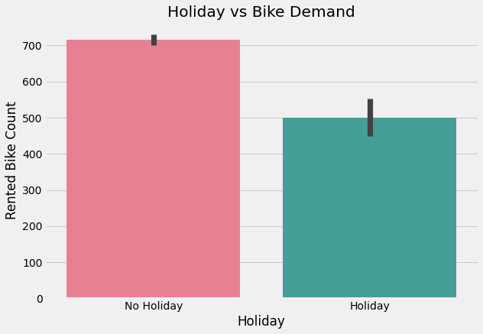
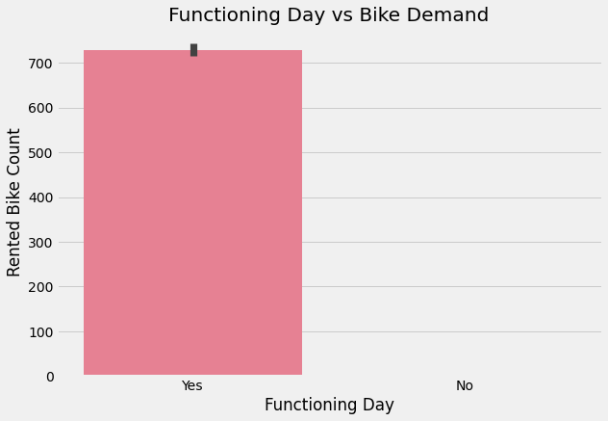
EXPLORATORY DATA ANALYSIS
CONCLUSIONS:
There is more bike demand when there is No Holiday and comparatively less bike demand when there is a Holiday.
It is clearly observed from the plot that there is no demand of 'Bikes' on Non Functioning Day or we can say that the rental company operates only on functioning day.

Slide 12
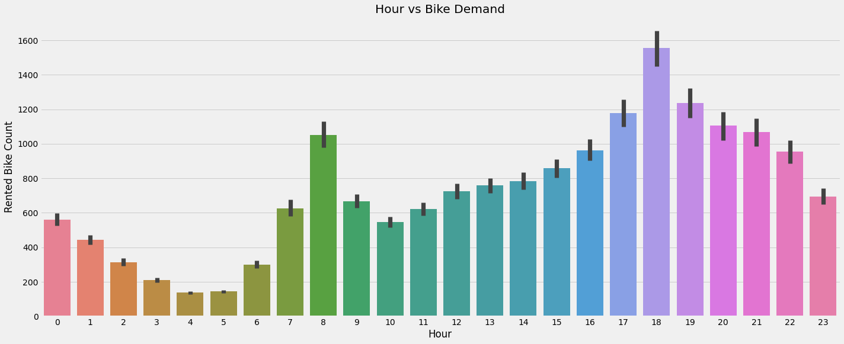
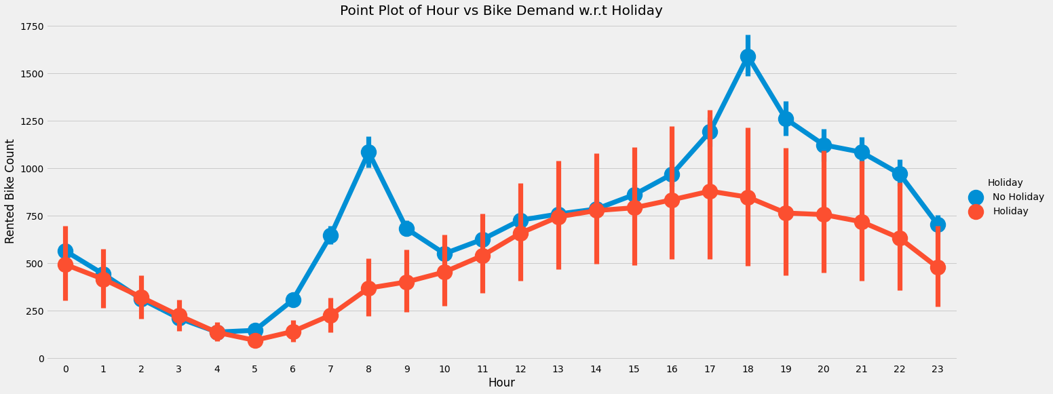
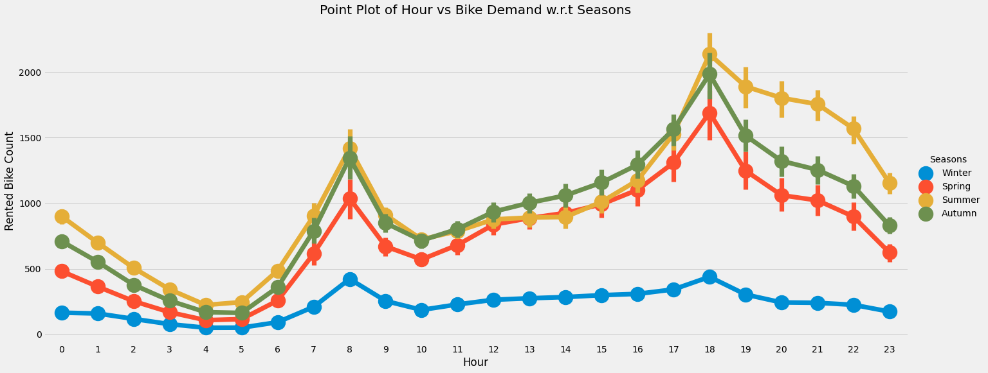
EXPLORATORY DATA ANALYSIS
CONCLUSIONS:
In the morning 8 O'clock has more bike demand and in evening 6 O'clock has most number of bike demands. Office hour, college hour, school hour might be the reason for surge in demands for these periods. Confidence interval for holidays is longer than that for non-holidays, this suggests that there is more variability in the data for holidays compared to non-holidays.

Slide 13
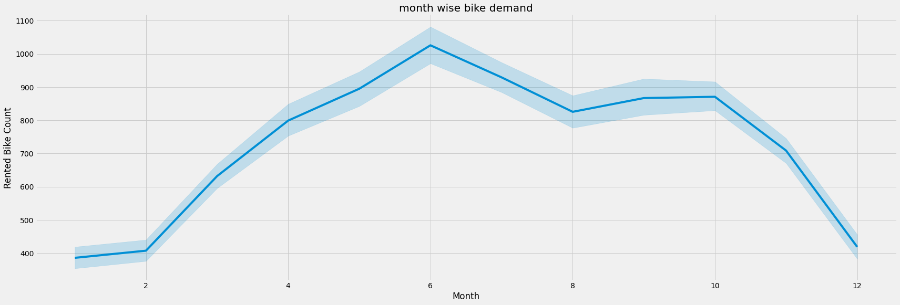
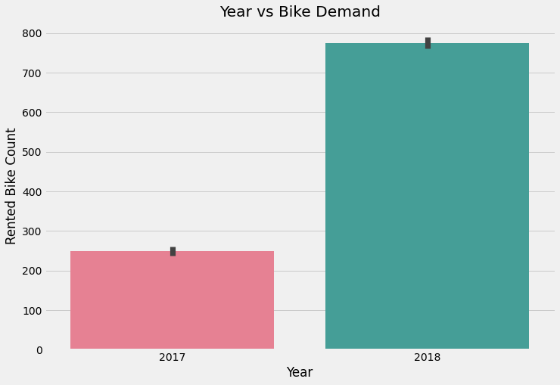
EXPLORATORY DATA ANALYSIS
CONCLUSIONS:
May and June has the most number of bike demands. These months generate good revenues to the Bike rental company.
Comparing two years 2017 and 2018,2018 has the most number of bike demands.Infact there is a tremendous surge in demand in 2018.

Slide 14
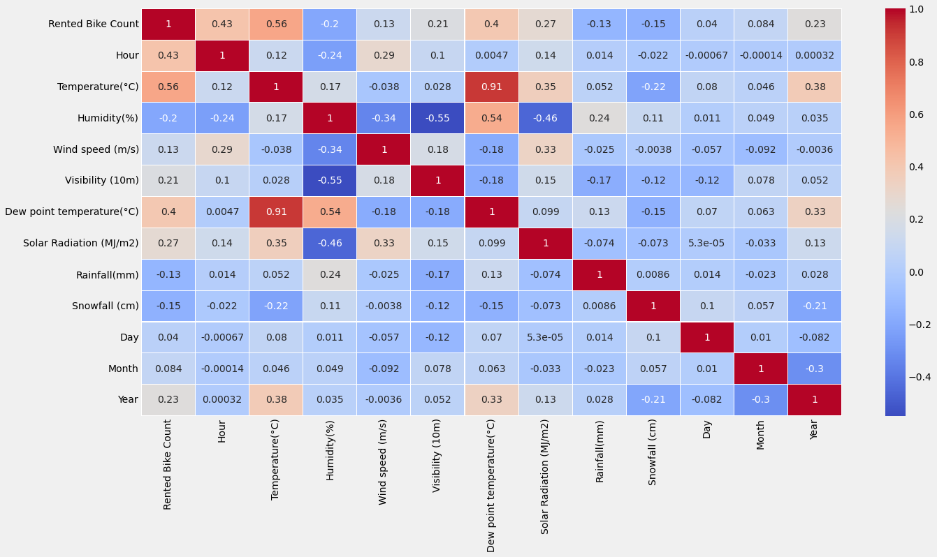
EXPLORATORY DATA ANALYSIS

Slide 15
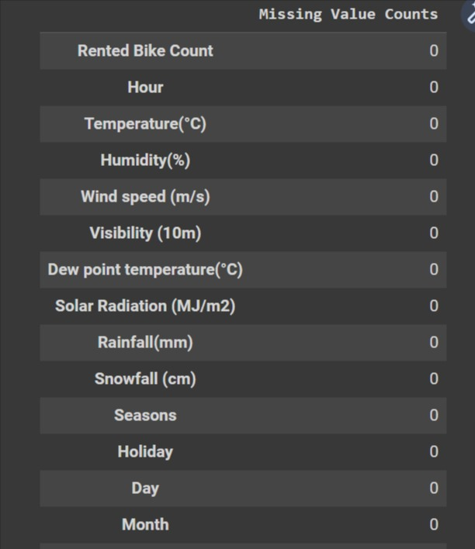
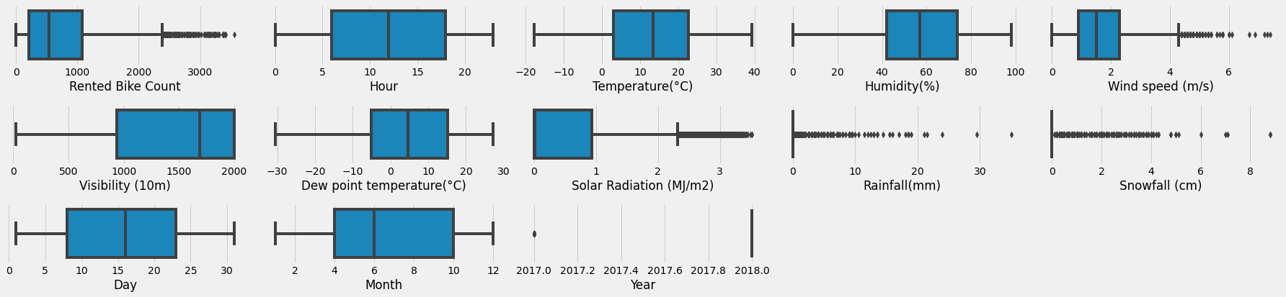
FEATURE ENGINEERING
MISSING VALUE IMPUTATION OUTLIER TREATMENT
DATA SCALING
I have used MinMaxScaler for scaling my data as it is a common normalization technique which transforms features by subtracting from the minimum value and dividing by maximum value, resulting in values between 0 and 1. This is useful in cases where we want to bound our values to a range and have the same scale across the features. This method is also scale-invariant and have some immunity towards outliers, unlike StandardScaler.

Slide 16
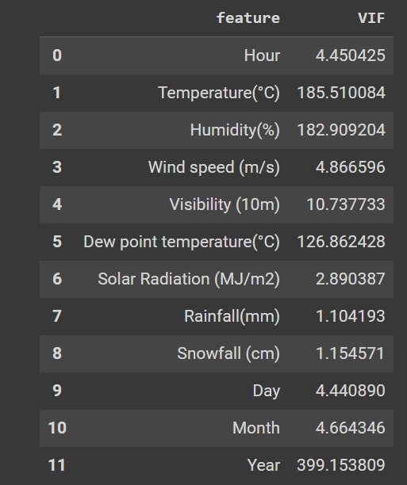
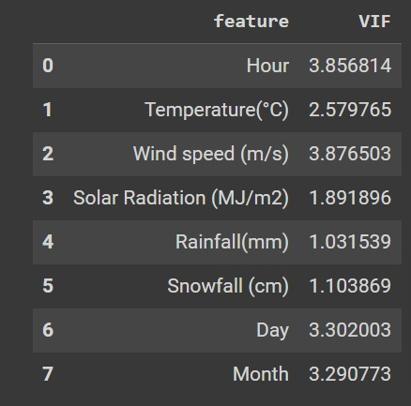
FEATURE ENGINEERING
CATEGORICAL ENCODING:
I have chosen OneHotEncoder as it is a versatile technique that can handle categorical variables with multiple levels, doesn't assume any ordinal relationship between categories, can handle missing data easily, less sensitive to small changes in data, less prone to overfitting, and more interpretable.
MULICOLLINEARITY:

Slide 17
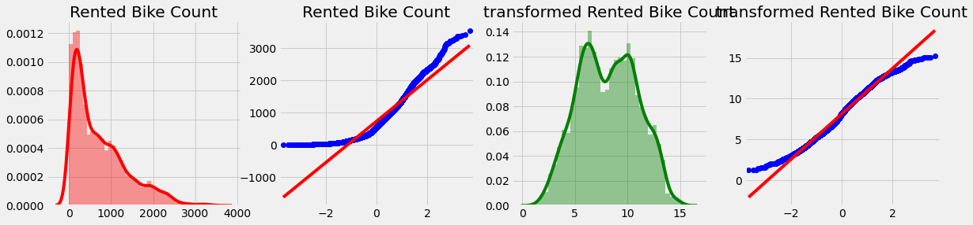
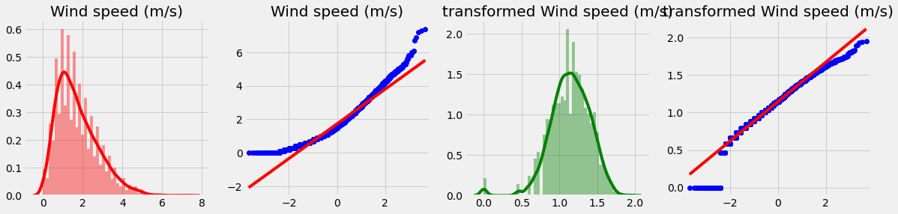
FEATURE ENGINEERING
DATA TRANSFORMATION
All the transformation we applied has more or less similar result. It is clear from the visualization that only feature 'Rented Bike Count' and 'Wind speed' shows a change in the distribution. That's why i will apply square root transformation on mentioned two features.

Slide 18
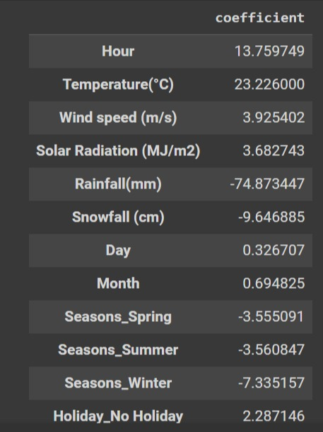
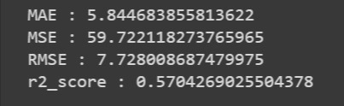
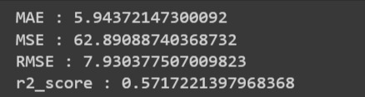
MODEL IMPLEMENTATION & EVALUATION
LINEAR REGRESSION
TRAIN SCORE
TEST SCORE

Slide 19
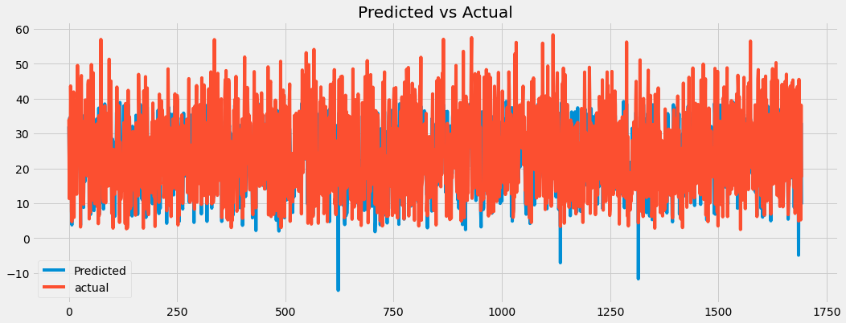
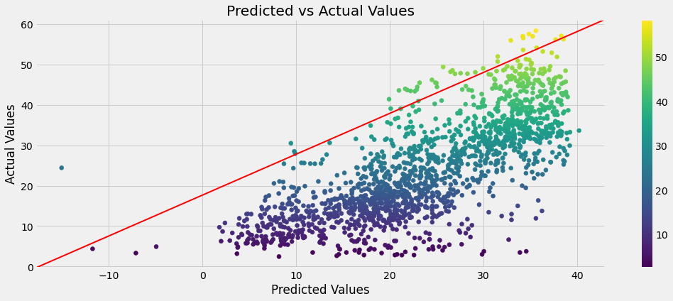
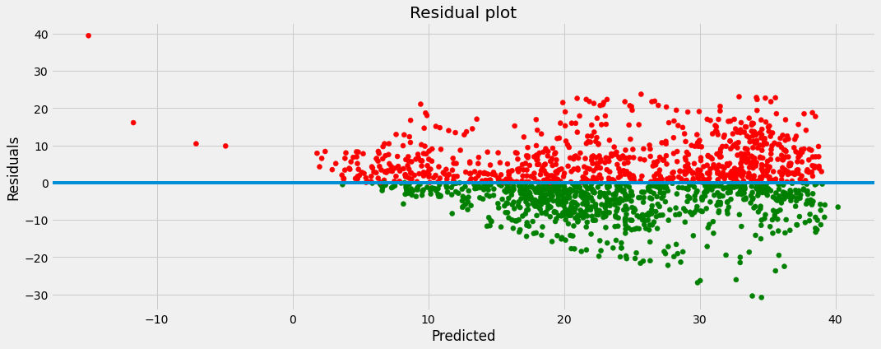
VISUALIZATION

Slide 20
1.One way to visualize the predicted vs actual values of a model is to create a scatter plot, with the predicted values on the x-axis and the actual values on the y-axis. Points on the scatter plot that fall on the y = x line indicate that the model is making accurate predictions. Points that deviate from this line indicate that the model is making errors.Hence model trained on "Linear Regression" is making lot of errors.
2. A residual plot is a scatter plot used to visualize the difference between actual and predicted values in a dataset. It shows the residuals (actual - predicted) on the y-axis and the predicted values on the x-axis. The purpose of a residual plot is to check for patterns in the residuals that may indicate a problem with the model being used for prediction. Ideally, the residuals should be randomly scattered around zero, indicating that the model is working well. If there is a pattern in the residuals, it may indicate that the model is not capturing some important aspect of the data and a different model may be needed. It can also be used to check assumptions of the model like normality of errors, overfitting and underfitting.

Slide 21
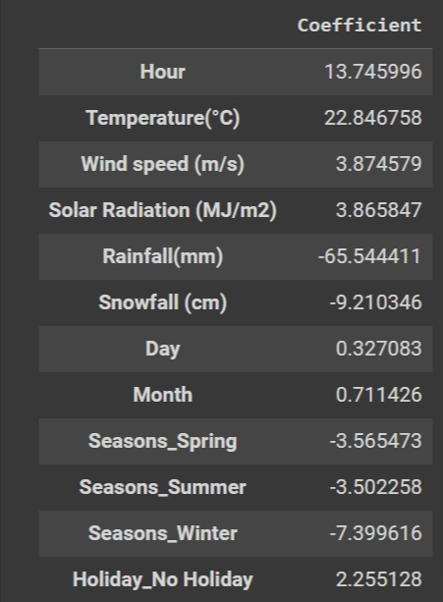
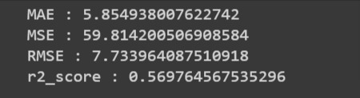
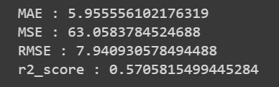
RIDGE REGRESSION
TRAIN SCORE
TEST SCORE

Slide 22
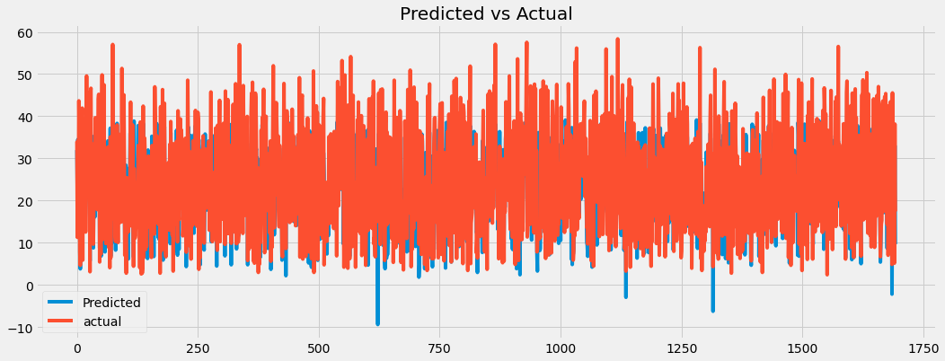
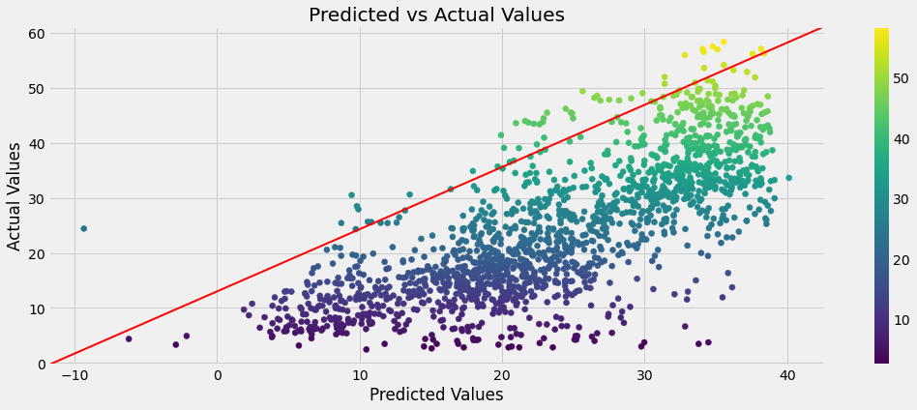
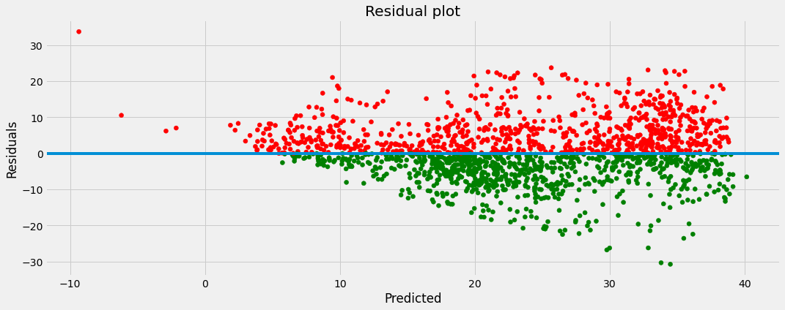
VISUALIZATION

Slide 23
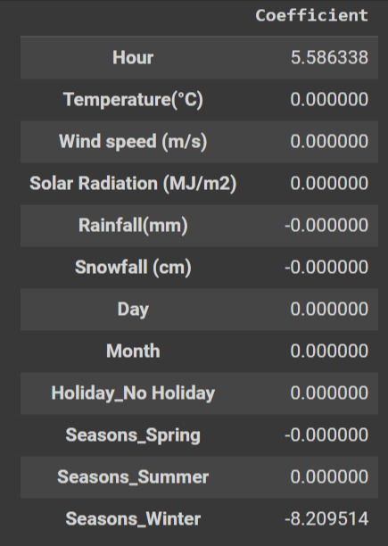
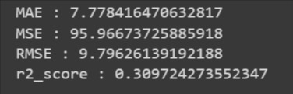
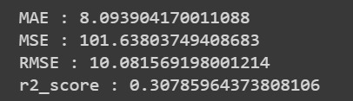
LASSO REGRESSION
TRAIN SCORE
TEST SCORE

Slide 24
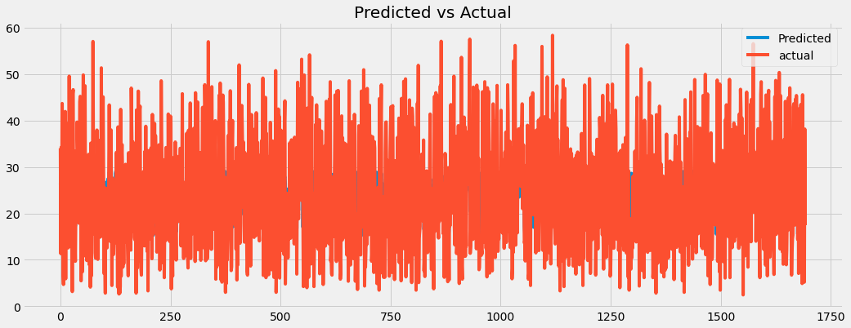
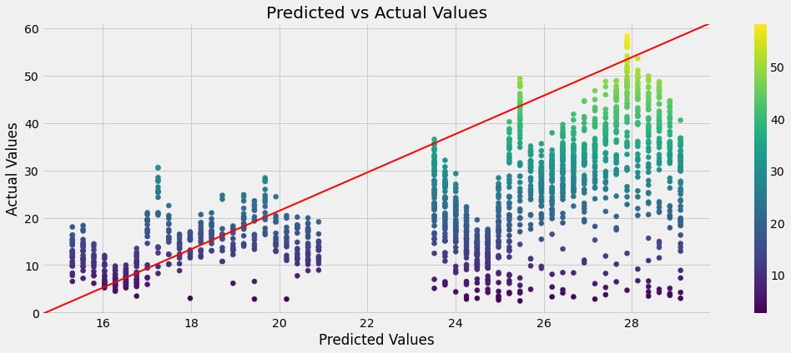
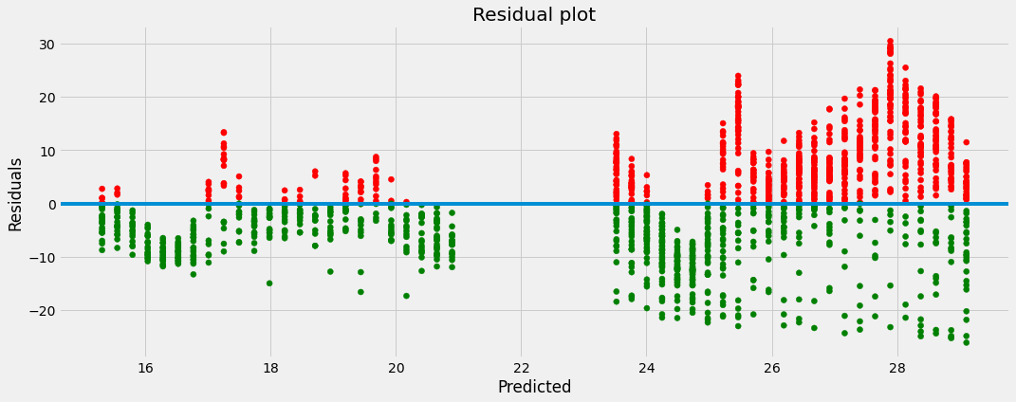
VISUALIZATION

Slide 25
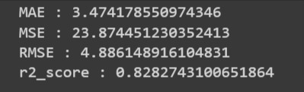
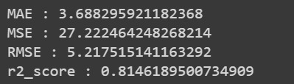
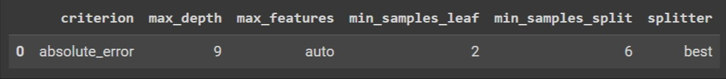
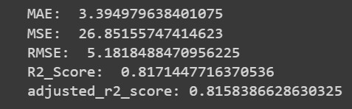
DESESION TREE REGRESSIOR
TRAIN SCORE
TEST SCORE
GRID SEARCH CV RESULTS

Slide 26
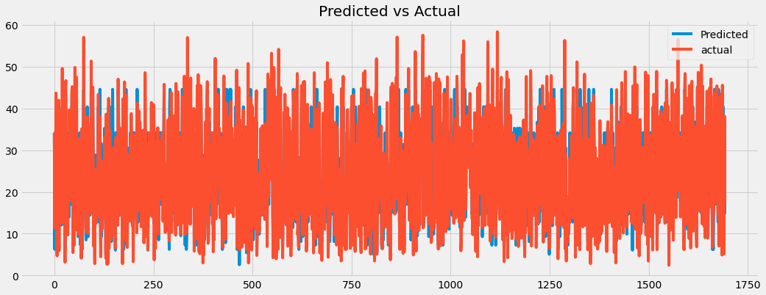
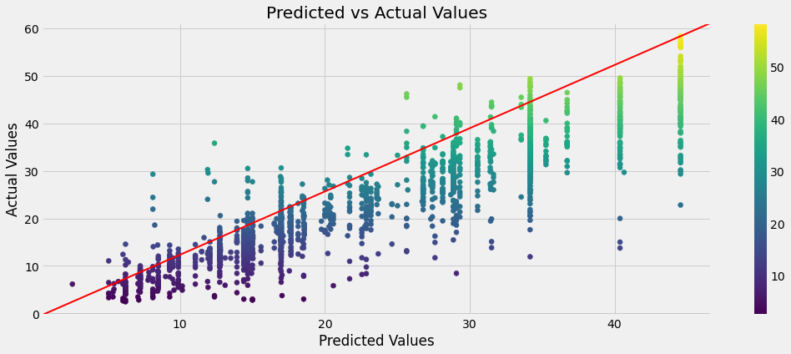
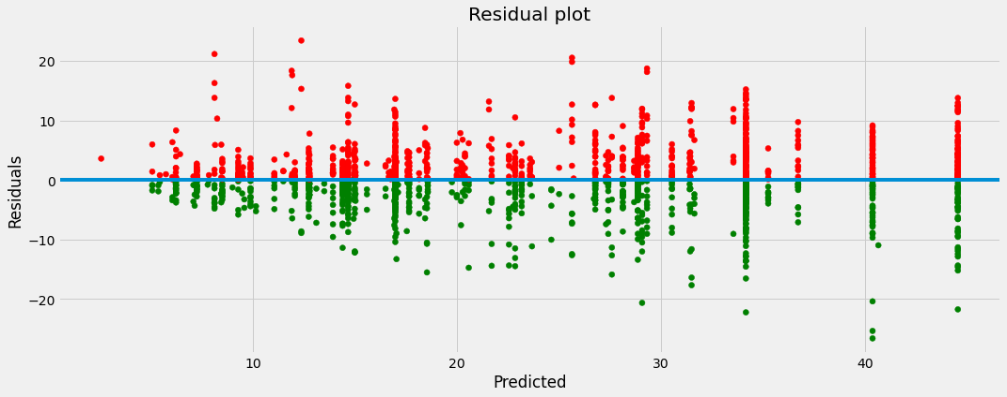
VISUALIZATION

Slide 27
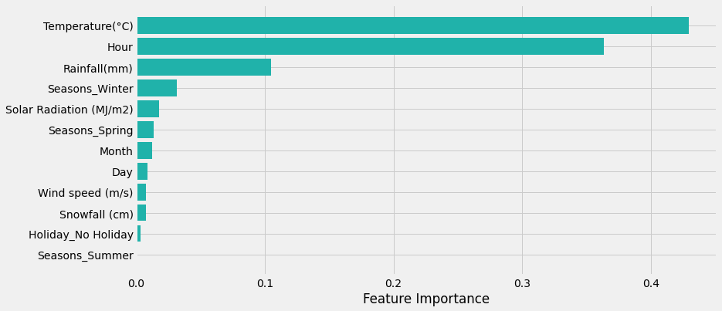
FEATURE IMPORTANCE PLOT
The feature importance gives an indication of how much each feature contributes to the predictions made by the decision tree regressor. In this case, the feature importance is giving higher weightage to the temperature feature, followed by hour, rainfall, winter season and solar radiation.
From this, we can interpret that the temperature feature has the greatest impact on the predictions made by the decision tree regressor. This means that the temperature feature is the most important feature in determining the output values. It is followed by hour, rainfall, winter season and solar radiation in descending order of importance.

Slide 28
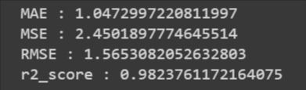
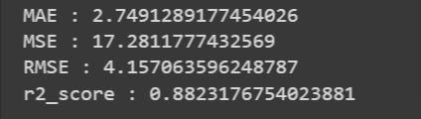


RANDOM FOREST REGRESSIOR
TRAIN SCORE
TEST SCORE
GRID SEARCH CV RESULTS

Slide 29



VISUALIZATION

Slide 30

FEATURE IMPORTANCE PLOT

Slide 31




GRADIENT BOOSTING REGRESSIOR
TRAIN SCORE
TEST SCORE
GRID SEARCH CV RESULTS

Slide 32



VISUALIZATION

Slide 33

FEATURE IMPORTANCE PLOT

Slide 34

EVALUATION METRICS SUMMARY

Slide 35
PROJECT CONCLUSION
Based on the results of the bike sharing demand prediction project, it appears that the gradient boosting regressor method was the most effective in terms of achieving a high R-squared score. This suggests that the gradient boosting model was able to effectively capture the underlying patterns in the data and make accurate predictions about bike sharing demand. Additionally, other models such as linear regression, Lasso regression, Ridge regression, Decision tree regressor, and Random Forest regressor were also used, but they did not perform as well as the gradient boosting regressor.
Overall, the project highlights the importance of evaluating multiple modeling techniques when working on a prediction task and choosing the one that performs the best on the given dataset. Additionally, it also showed the effectiveness of the gradient boosting regressor model in the prediction of bike sharing demand.

Slide 36
THANK YOU

